Slide 1
Gogile
LF
A
The gogile development process

Slide 2
Why Gogile?
Does this sound familiar?
Your backlog is a huge mess of new and old tasks. Duplicated, oversized, undersized, should have been a bug, no longer relevant tasks and stories.
You spend way too much time in refinement meetings, sprint planning, task estimation.
When starting a task, the developer needs to ask the creator what is actually intended
Your estimates are inconsistent and inaccurate.
The developers are fed up with being asked to estimate poorly described tasks.
Tasks gets stuck in ping pong between ”In progress/rework” and ”Testing”
High workload for product owners and product managers producing output that is never used
Your project started out at a high pace but gradually slowed down as you went along

Slide 3
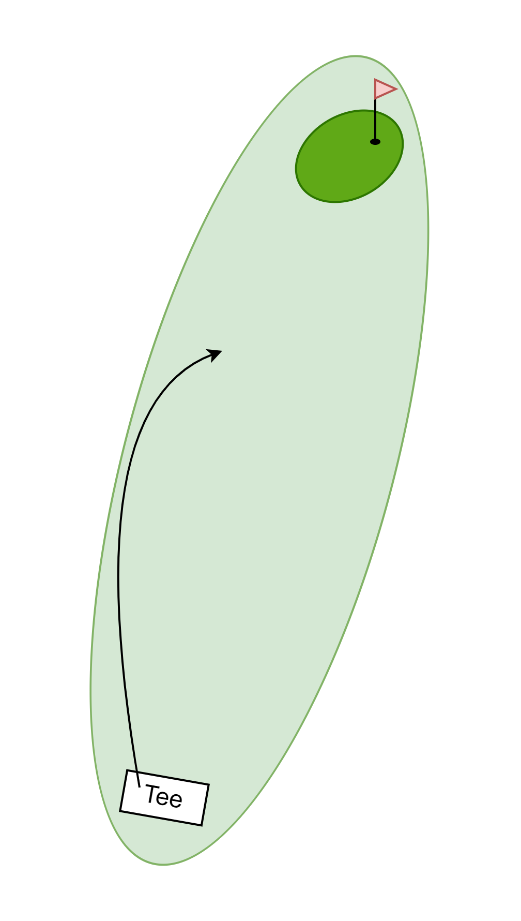
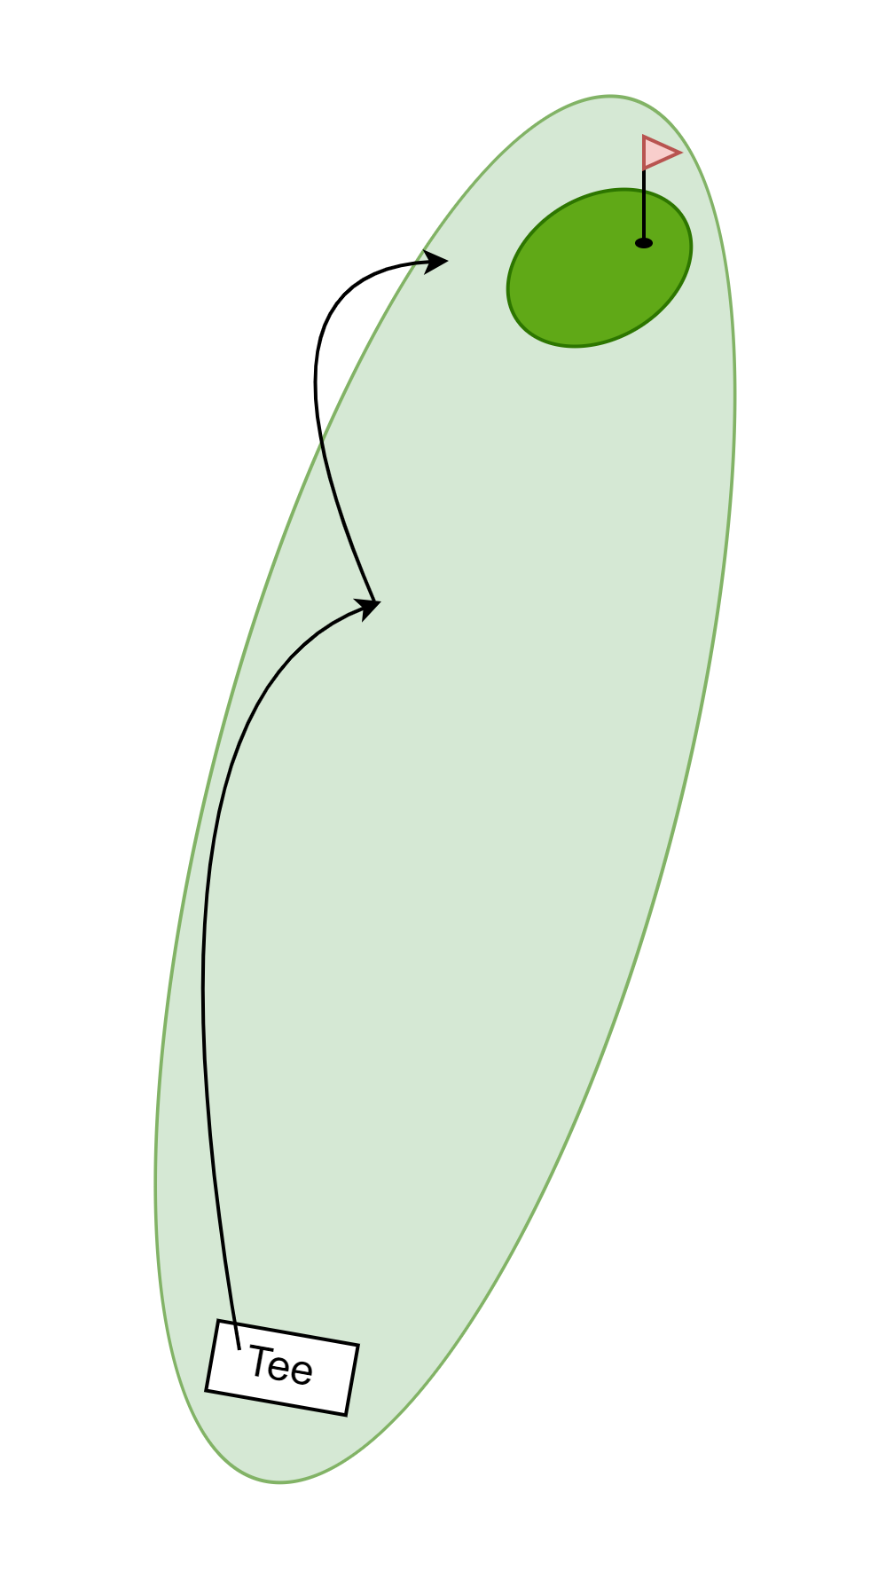




The golf analogy
When you play golf you play a course consisting of a number of holes (usually 18). Each hole has a starting point (the tee) and a hole. The player's goal is to get from the tee to the hole in as few strokes as possible, for each hole. Some holes are short, some are long.
The course
A number of holes (usually 18)
A drop/release
The hole
Tee
Strokes
Hole/Goal
An Epic
Stroke types in golf (tasks)
A drive is a long-distance stroke.
A pitch is a medium distance stroke.
A chip is a short distance stroke.
A putt is a very short distance stroke.
The longer the stroke/task, the lower the accuracy.

Slide 4
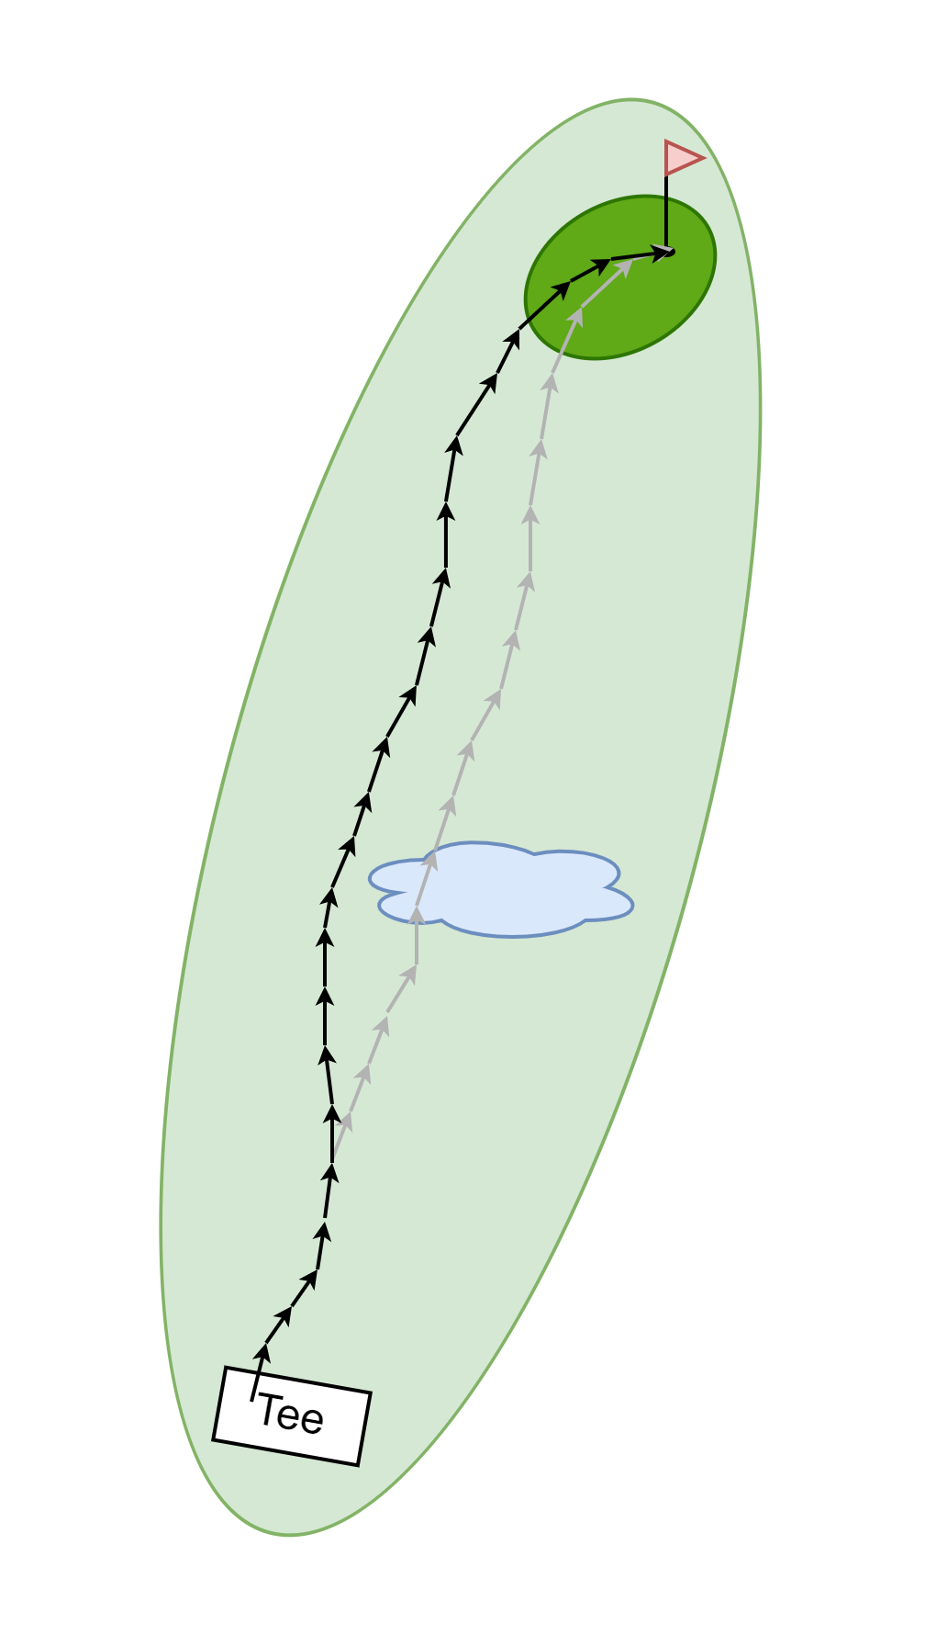
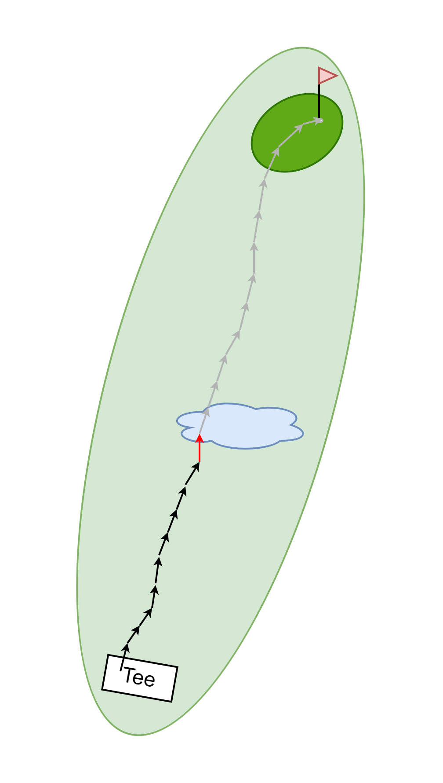

Scrum
PO, DM, Devs, testers meet. The PO explains what the goal, "the hole", is
They plan a large series of small tasks that will get project to that goal. The tasks are kept small to give flexibility and estimation accuracy.
After 10 putts the PO realizes that this is not really heading in the right direction.
Everyone backtracks 5 strokes and tries to get back on track. The tasks originally planned stay in the backlog, to be completed when the group arrives there. (Spoiler: they will never get there and the tasks will exist in the backlog for the rest of the project).
After 25 putts the ball is in the hole and the group starts planning the tasks for the next hole, that needs to be started ASAP.

Slide 5

Gogile
Before starting
The PO, DM, Dev, Caddie(s) and Testers discuss the goal for this first hole.
The goal should be achievable in approximately 2 weeks
The Dev is asked what they would spend 3-5 days on to get as close to that goal as possible. This is a "drive".
At the end of that task the work should be mergeable and stable.
The drive doesn't have to be accurate, as long as long as it gets the team closer to the goal
A task documenting this work is created
Testers focus on the hole and get to work on how to test everything once the ball is in the hole.
After each task
The Dev get to work and after completing the task there is no testing. Instead, the Dev and Caddie meet to define the next stroke/task. The PO can be included in the stroke planning if their guidance is needed to ensure work is contributing to the goal.
Depending on the outcome of the drive they might plan a pitch, chip or putt (M/S/XS task).
This is repeated until the ball is in the hole. At that point, the testers should have tests defined to see how well the full product fulfills the requirements after this hole.
There is no backlog. All tasks are planned with the completion of the previous one. This ensures all tasks are created with the maximum amount of knowledge and always started after being created.

Slide 6
What Gogile does differently
"How long will this take?" -> "What would you do with this amount of time?
Estimations together with the implementor, reducing the inaccuracy caused by "It would take ME this long, but I don't know how long Jane Doe would need" discussions.
Devs should focus on planning and performing the "strokes". They need to understand the goals for the hole and the course goals to ensure architecture is aligned with the bigger picture.
Devs need to take more responsibility for the task planning, but there will be less of it
It will take a lot more small meetings with focused groups to plan each stroke, but time will be freed up by removing long backlog refinement meetings in large groups, sprint planning meetings etc.
High level estimations, such as "How long will this project take and what resources are needed?", will be performed outside of this process by POs, DMs, PMs, tech leads and SMEs.
Bugs
Bugs are left out of the process. Bugs should be tracked separately and tested immediately after fixing.
Testing
Testers should focus on testing the product based off requirements and functional designs, instead of testing individual tasks. Continuous testing can generate bugs or the need for new "holes" to be added to the course.
PO should make sure there are clear, well defined, goals/"holes" and attend the stroke planning to make sure it's aimed at the target.
DM should look at the "course" and ensure the correct resources are in place at the right time. Also DM should make sure work that is depending on other teams is aligned and prepared.

Slide 7

We own the process!
This is OUR process.
We can change it any way we like.
Please help us evolve this into the best process possible for our team!

Slide 8
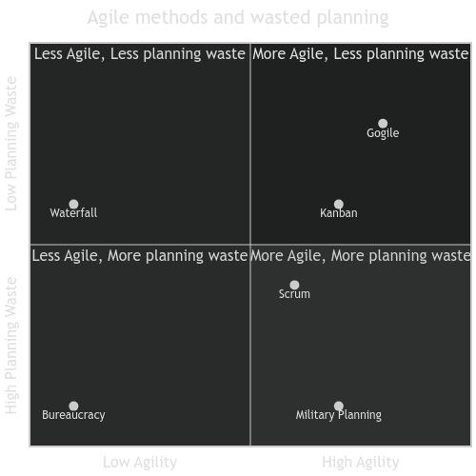
Method comparison
Waterfall
Not very agile, Planning waste is ideally low, but in reality realizations during development create planning waste.
Scrum
More agile, but only between sprints. Planning waste comes mostly from trying to plan everything before starting the sprint
Kanban
Higher agility. Planning waste comes from filling up the backlog with tasks based on the current state. When the current state changes, already created tasks might become stale.
Military planning
The end goal is clear. Plans to achieve it are created along with large amounts of contingency plans for unexpected outcomes. Fairly agile thanks to the contingency plans.
Huge planning waste, since most contingency plans are newer used.
Bureaucracy
Very low agility caused by endless discussions and passing of decisions to different instances.
Very high planning waste, caused by planning effort being extremely high compared to the actual outcome.
Gogile
High agility, since all actions are started from the current state with the most up to date knowledge.
Low planning waste, since pre planning is limited. Planning is done when it's ready to be put into action.

